Slide 1

BRITISH AIRWAYS
Customer ratings analysis
13.01.2024

Slide 2
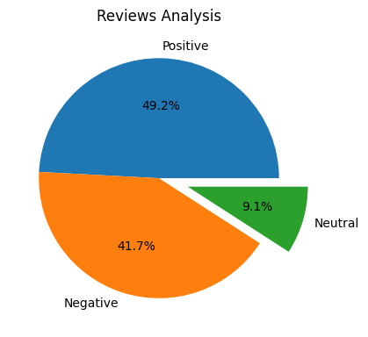
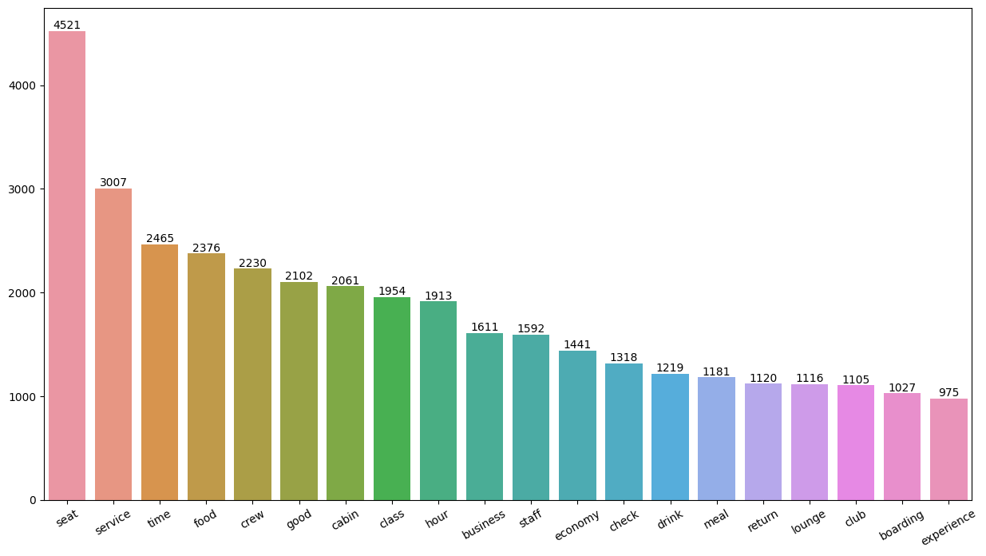
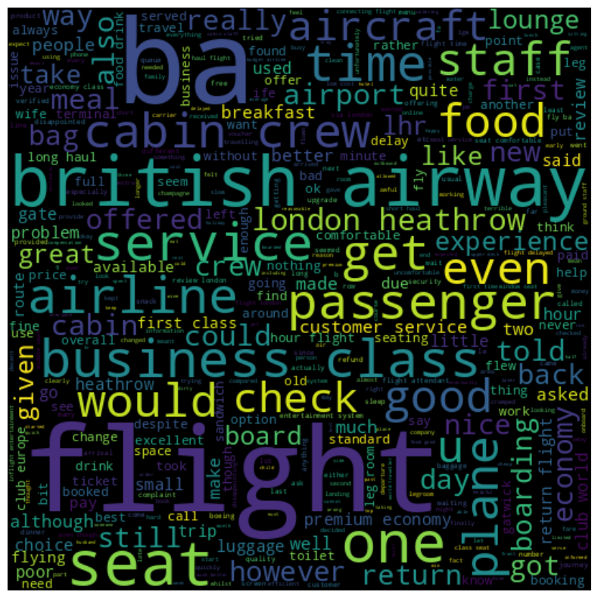
KEY METRICS
Average Overall Rating
4.73 /10
3728 Total reviews
collected
Review Analysis
Positive –1833
Negative –1555
Neutra -340
Below All customers expressed satisfaction with the cabin crew service, staff, and the overall comfort of economy seats. Additionally, a considerable number of customers opted for Business class during their travels.
Word Cloud of Keywords used

